Slide 1
Public Perception on AI Ruoxi Hou

Slide 2


Project analysis slide 6
Public Perception on AI Purpose
“Nearly $14B has been invested into Generative AI through the first half of 2023. This represents nearly 40% of total VC investment in the first half of 2023 and an astounding 3x increase on the total capital invested into the sector from 2022.”
"AI systems can now pass medical or legal exams, increase white collar productivity in many occupations by over 50%, generate new photo realistic images, and help power more dangerous, autonomous weapons."
"Overall, 52% of Americans say they feel more concerned than excited about the increased use of artificial intelligence. Just 10% say they are more excited than concerned, while 36% say they feel an equal mix of these emotions."
Goal: To find public opinion on AI in different fields from customers' perspective to provide insights for Venture Capital Companies in terms of their investment on AI industry.
Example: Sequoia Capital.

Slide 3
Project analysis slide 3
Public Perception on AI Data Analysis
Data Collection
Data Wrangling
Hypothesis Testing & Estimation
EDA
Model Prediction
Survey (163 records) was distributed on Qualtrics & SurveyMonkey;
Open Dataset was selected from Kaggle;
Web Scrapping was made on Sequoia Cap(Selenium) with 57 records
Data Cleaning
Categorization
One-hot Encoding
One-Way ANOVA
Post Hoc test (Tukey’s HSD)
with 95% Confidence Level.
Demographic Data V.S Ratings
Logistic Regression
Cross Validation
Combination
Precision Score

Slide 4
Project analysis slide 10
Project Analysis Data Analysis
Questions besides demographic data
Knowledge
How much do you think you know about AI?
In general, how much would you like to use AI to solve practical issues?
General
Under the circumstance that conversational AI (e.g. chatbot, virtual agent) can provide you immediate customer service and accurate solutions, how much are you willing to use this AI?
Customer Relationship Management
Imaging you have a chronical illness, how much are you willing to share your data (including medical records) with healthcare AI via sensors and software to monitor your health at home?
Healthcare Use
Under the circumstance that self-driving AI technology has passed all the qualification tests, how comfortable are you to sit in a self-driving car?
Self-driving Vehicle
Law Firm Related
Under the circumstance that contract AI can generate high-quality legal contracts, how much are you willing to sign on an AI generated legal contract initiated by your counterparty?

Slide 5
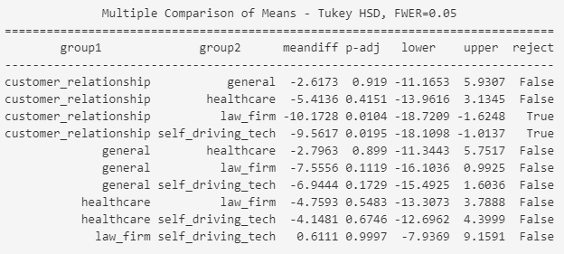
Project analysis slide 8
Project Analysis Data Analysis
Hypothesis Setting
Hypothesis Testing
H0:
One-Way ANOVA
Customers' opinions on the 4 different AI products, namely "Customer Relationship Management", "Healthcare Use", "Self-driving Vehicle", and "Law Firm Related" and their General opinion on AI are the same.
f_statistic, p_value = stats.f_oneway(…) alpha = 0.05
F-statistic: 3.9325592796237743, p-value: 0.003609137552494191
Reject the null hypothesis. There is a significant difference among group means.
Ha:
At least one of 5 customers' opinions on AI, namely "Customer Relationship Management", "Healthcare Use", "Self-driving Vehicle", "Law Firm Related" and general opinion is different from the others.

Slide 6
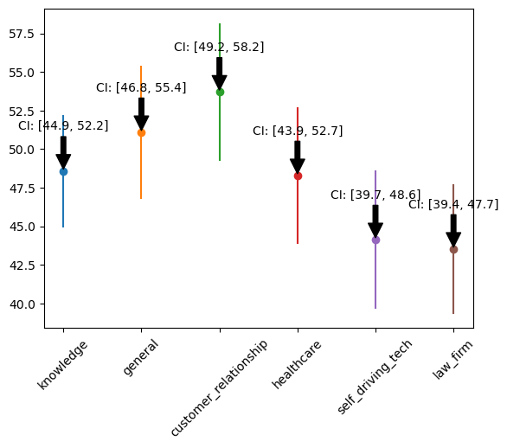
Project analysis slide 10
Project Analysis Data Analysis
Estimated Ratings in the Population(10-100)
The public believe they know a less-than-moderate amount of knowledge about AI
The public's willingness of using AI to resolve practical issues is in a moderate amount
The public are more likely to use AI for the purpose of Customer Relationship Management, and less likely to use AI for Self-Driving Vehicle and Law Firm
Suggestion to Sequoia Cap: Based on the rating for each type of AI and the company’s actual budget, the investment for each field can be adjusted.

Slide 7
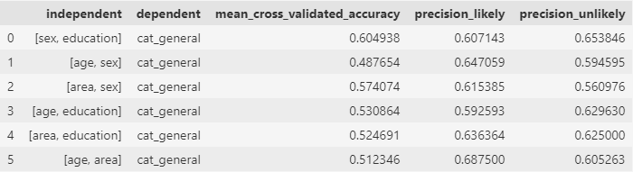
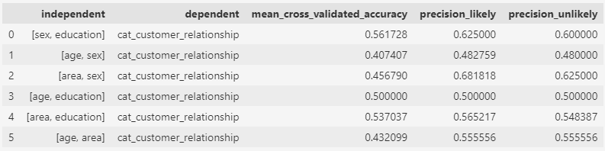
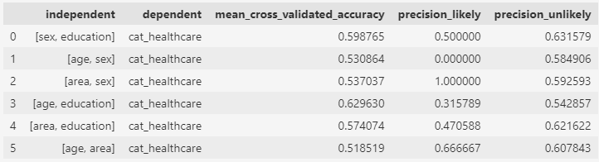
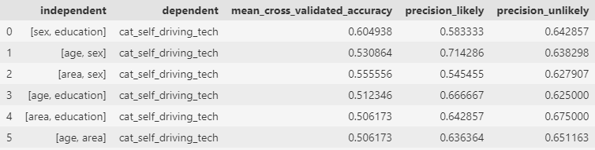
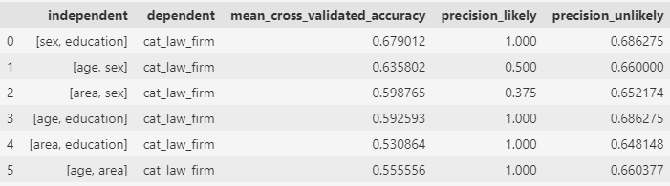
Project analysis slide 5
Project Analysis Data Analysis
mean_cross_validated_accuracy
Precision: 0/1
Cross validation
zero_division=1
The accuracy score obtained from cross-validation represents the ratio of correctly predicted instances to the total number of instances.
1: The denominator is zero
0: There are no true positives.
precision_likey/unlikely
Precision Score
Precision for "likely": The ratio of correctly predicted "likely" instances to the total number of instances predicted as "likely."
Precision for "unlikely": vice versa

Slide 8
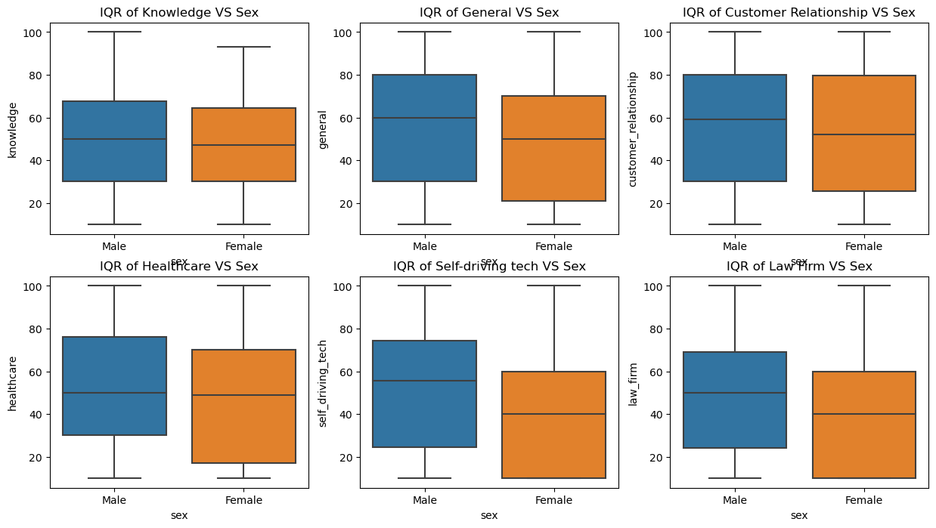
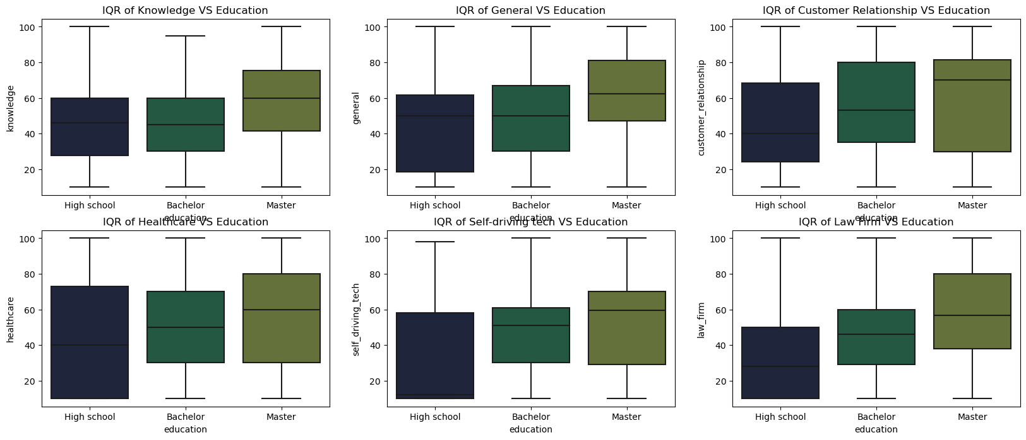
Project analysis slide 5
Project Analysis Data Analysis
EDA Finding 1
EDA Finding 2
Sex
Education
Male has a higher tendency of using AI for all 5 scenarios
Respondents with higher levels of education are more likely than others to give higher ratings in all categories.

Slide 9
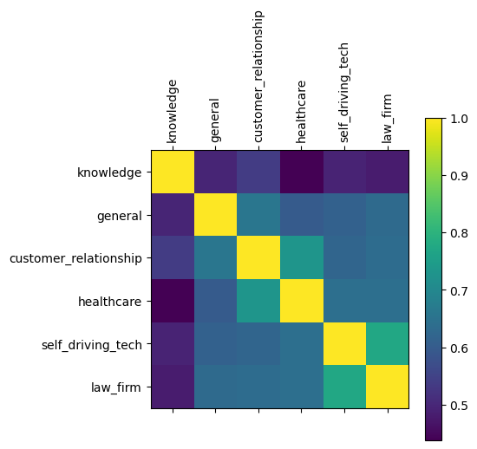
Project analysis slide 5
Project Analysis Data Analysis
EDA Finding 3
Correlation
-knowledge does not seem to have very strong correlation with any of the ratings
-Rating of customer_relationship seems to have a high correlation with healthcare
-Rating of self_driving seems to have a high correlation with law_firm

Slide 10
Project analysis slide 4
Project Analysis Future Improvement
Tasks
More Types of AI
Modified Model for Prediction
Balanced Data in each Category
Bigger Sample Size

Slide 11
Thank You

Slide 12
Project analysis slide 4
Project Analysis Reference
https://publicfirst.co.uk/ai/
https://www.pewresearch.org/short-reads/2023/08/28/growing-public-concern-about-the-role-of-artificial-intelligence-in-daily-life/
https://marchcp.com/the-rise-of-generative-ai-a-tale-of-two-venture-markets/
https://www.ibm.com/blog/understanding-the-different-types-of-artificial-intelligence/
https://www.kaggle.com/datasets/adnananam/largest-us-venture-funding-deals-of-2023
https://www.sequoiacap.com/our-companies/

